Slide 1

Exploring Project Structure
with itronics

Slide 2
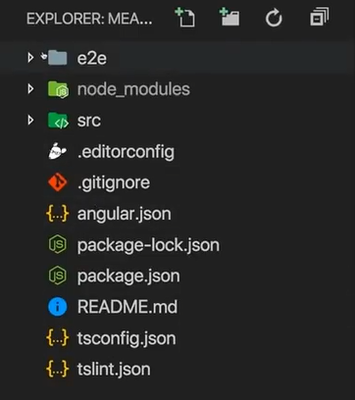
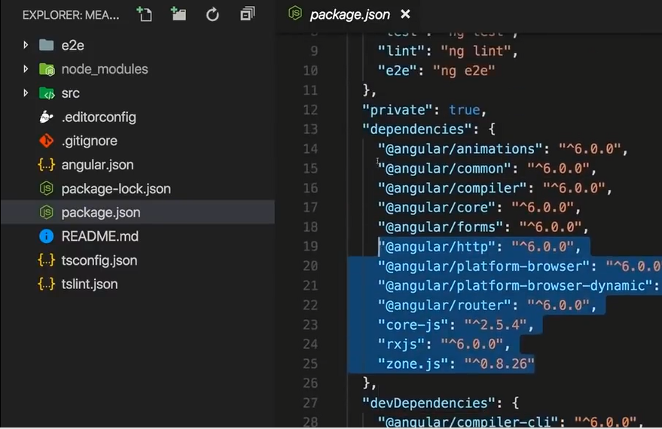
Angular CLI New Project Folder
MongoDB dependencies located in src folder at package.json file

Slide 3
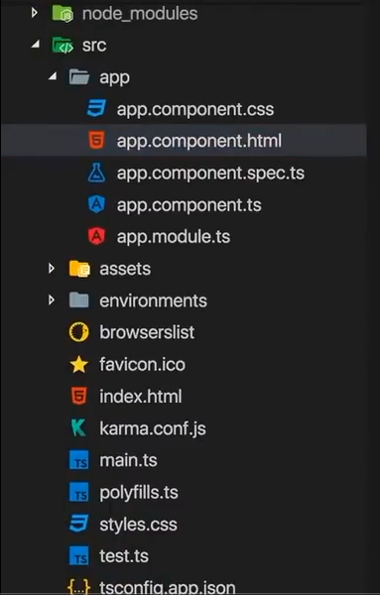
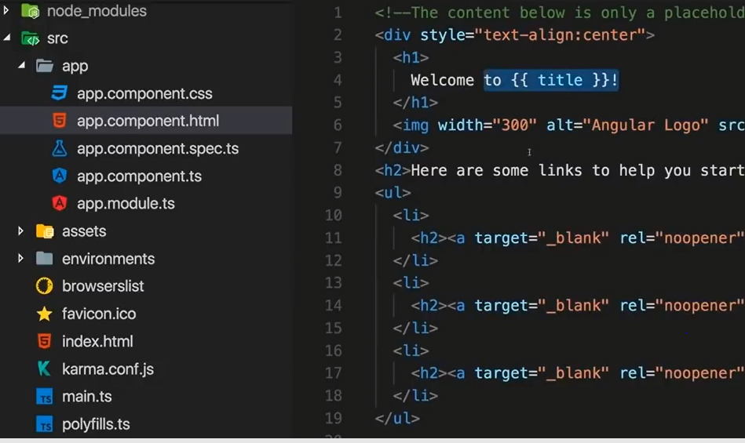
App folder for create Angular Web App Front-End
Dynamic Front-End Web Page Angular Code at app component.html

